Slide 1

Introduction to Arduino
IEEE City Robotics Society

Slide 2
Introduction
Timeline of Events
Follow the Line Competition Format
Set up and Installation of Arduino
Social Activities
Today’s Agenda

Slide 3
Committee Introduction
Co-chairs: Alan and Fatimah
Vice-Chair: Bansari
Treasurer – Zack
Social Media Officer – Jude
Teaching Assistants – Ali and Million

Slide 4

Timeline for our upcoming events
Programming Workshops
(C++ and Arduino )
Quality Testing and Final Testing
Competition Preparation
Arduino Installation + Set up
Follow the Line Competition

Slide 5
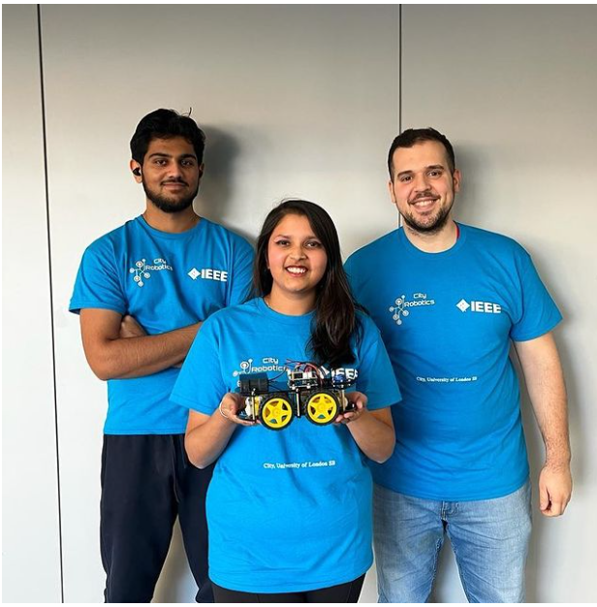

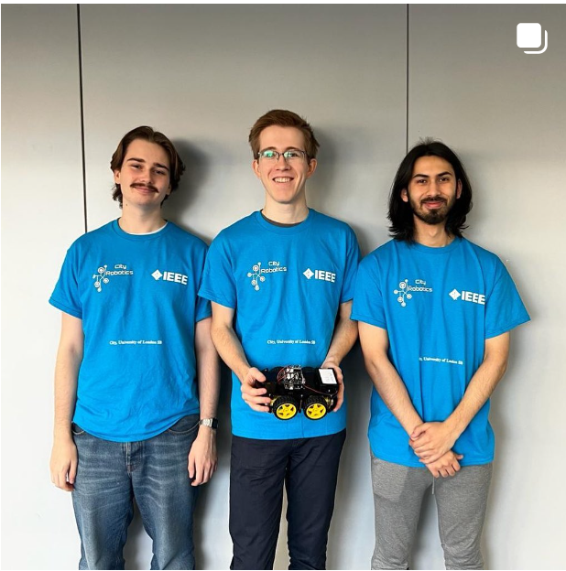
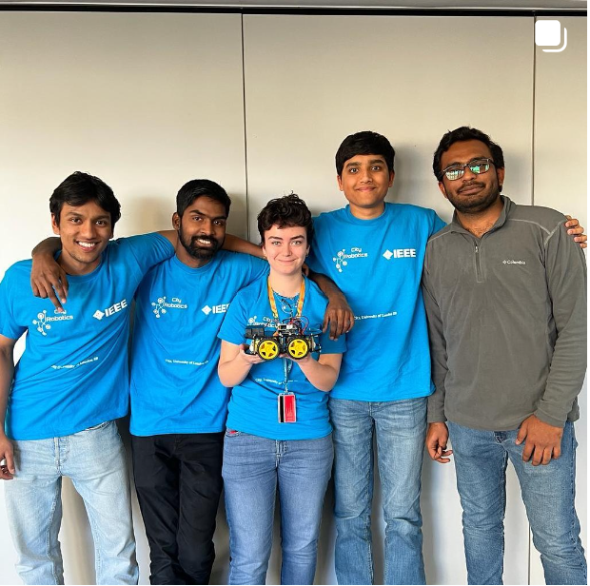
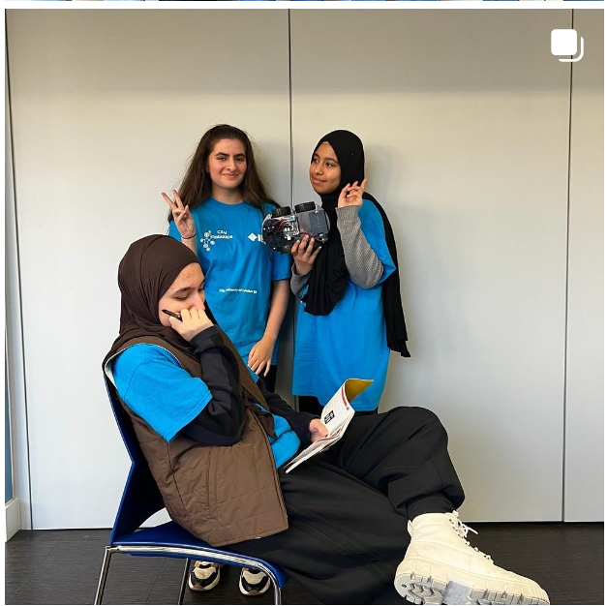
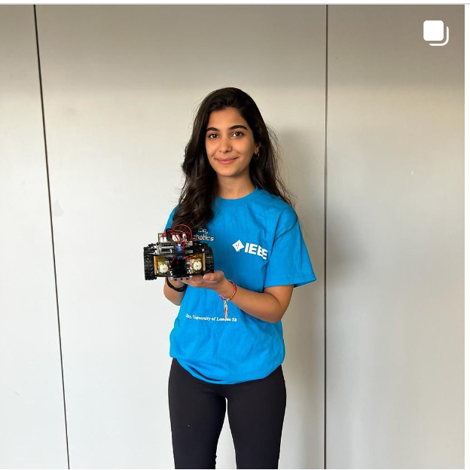
Teams that Competed Last Year

Slide 6
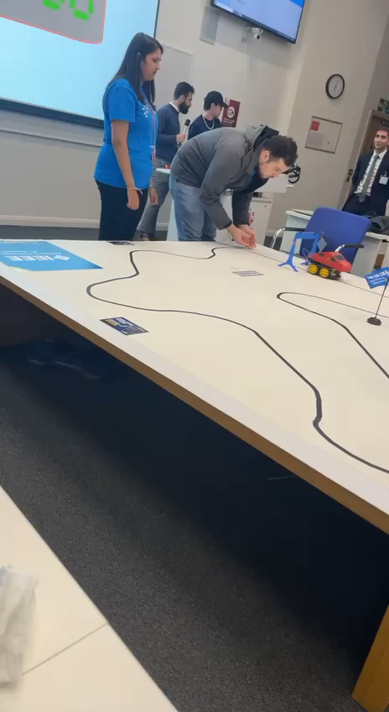
Pre-view:

Slide 7

Follow the Line Competition
Team Competition – 4/5 students per team
During the competition, your robot must complete the whole track.
Judged based on lap time.
If the robots goes out of the line, you will be deducted points.
You will be coding using C++ and the Arduino IDE Environment.

Slide 8

Prizes to be won:
Best Lap time award
Best Design (by peer voting) award
Most efficient code award

Slide 9

Let’s do the installation

Slide 10
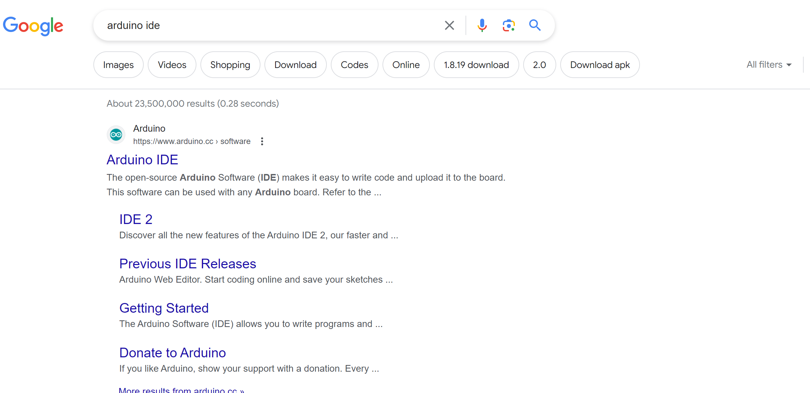
Installation and setup of Arduino
Step 1: Type in Google Search ‘ Arduino IDE’

Slide 11
Installation and setup of Arduino
Step 2: Click on the top link

Slide 12
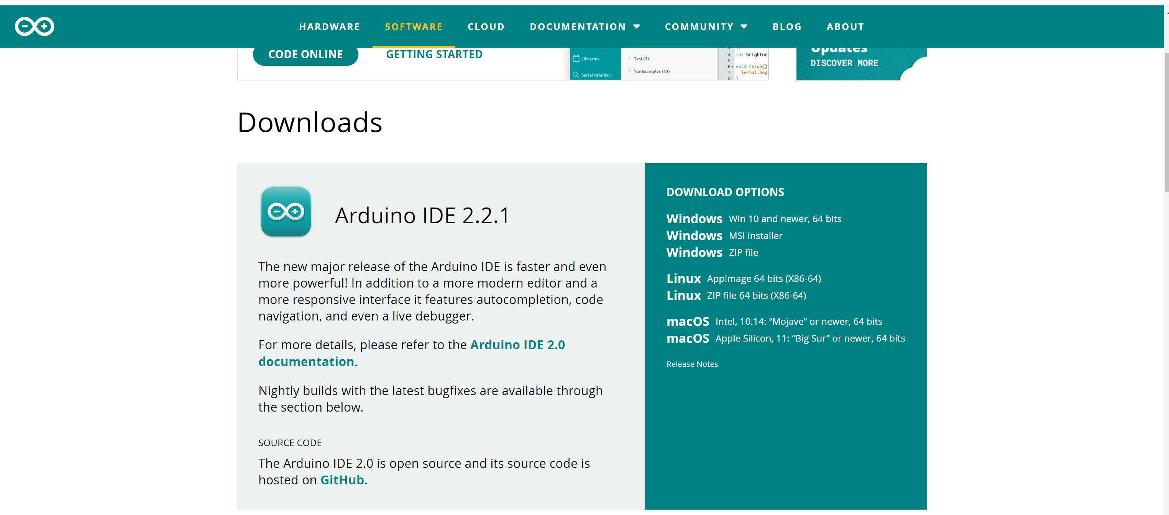
Installation and setup of Arduino
Step 3: Locate your version you need + click download

Slide 13

Installation and setup of Arduino
Step 4: Make sure that Arduino Uno on COM4 is selected.

